Slide 1
Image Convert Tool 1.0
By Doudou Nan & Shihui Chen

Slide 2
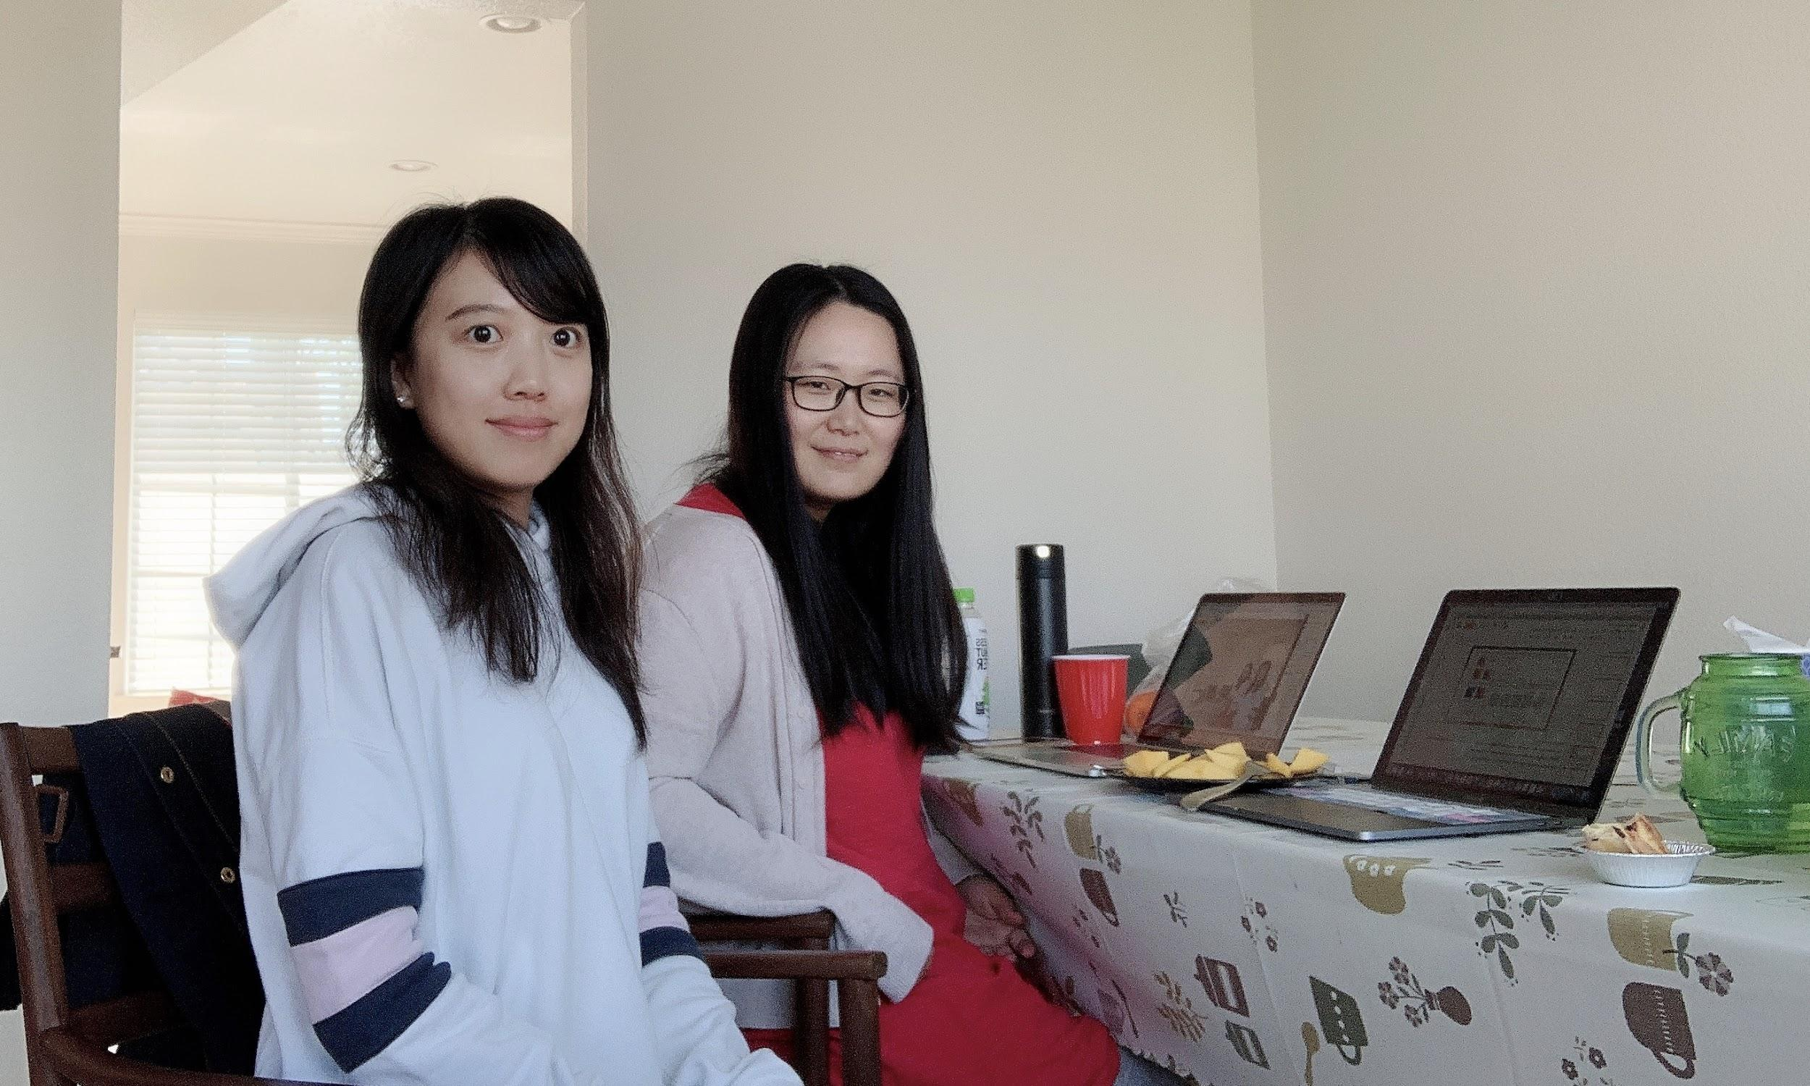
TEAM

Slide 3
Content
Language and GUI
Design Pattern
Configuration and Function
Demo

Slide 4
Language and GUI
Java
ImageMagick
Im4java
javaxt
GUI
JavaFx
Notes:
To implement the software, we used java libraries imageMagick, and im4java in the interface of imageMagick. We also use javaxt for some additional functions. As require, the graphic user interface we use javaFx.

Slide 5
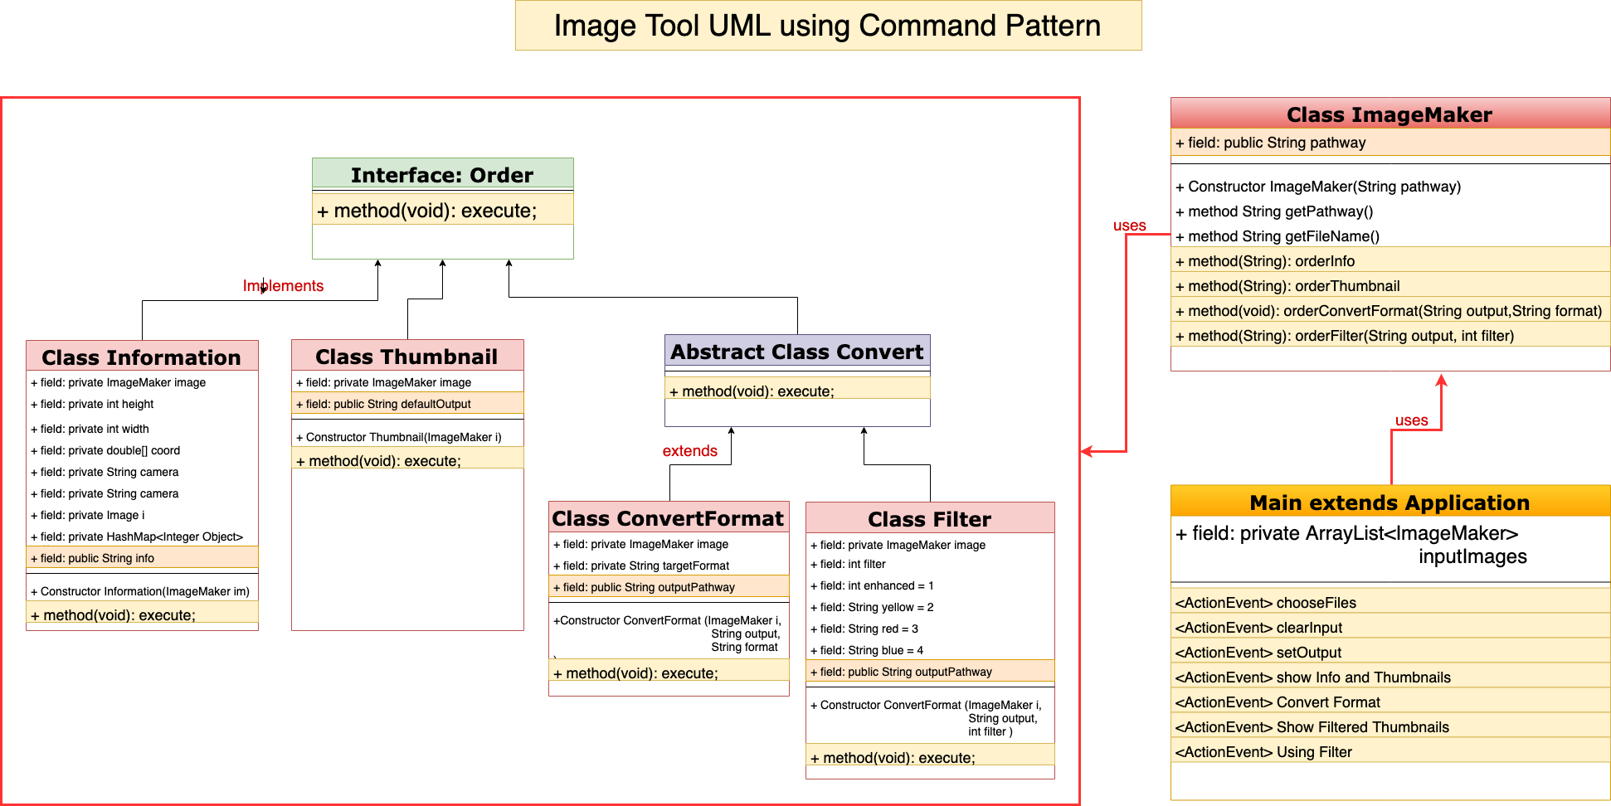
Notes:
This is our design pattern. We use this pattern to execute our project.
First, we have created an interface Order which is acting as a command. Second, We have concrete command classes Information, Thumbnail and Convert which are implementing Order interface. We also have 2 sub classes extend the convert class. These classes will do actual command processing. Third, we created a class called ImageMaker which acts as an invoker object. It can easily take and place orders.
ImageMaker object uses command pattern to identify which object will execute. At the end, our main class will use ImageMaker class to demonstrate command pattern.
Why do we choose this pattern?
As we know, command pattern has many advantages. It is convenient for users to Undo or Redo commands. Also, developers can easily add a new command into our system. In our case, we created 2 sub classes extend the abstract convert class in order to allowing developers to add more functions here. For example, we can add a class called Resize to resize the image.

Slide 6
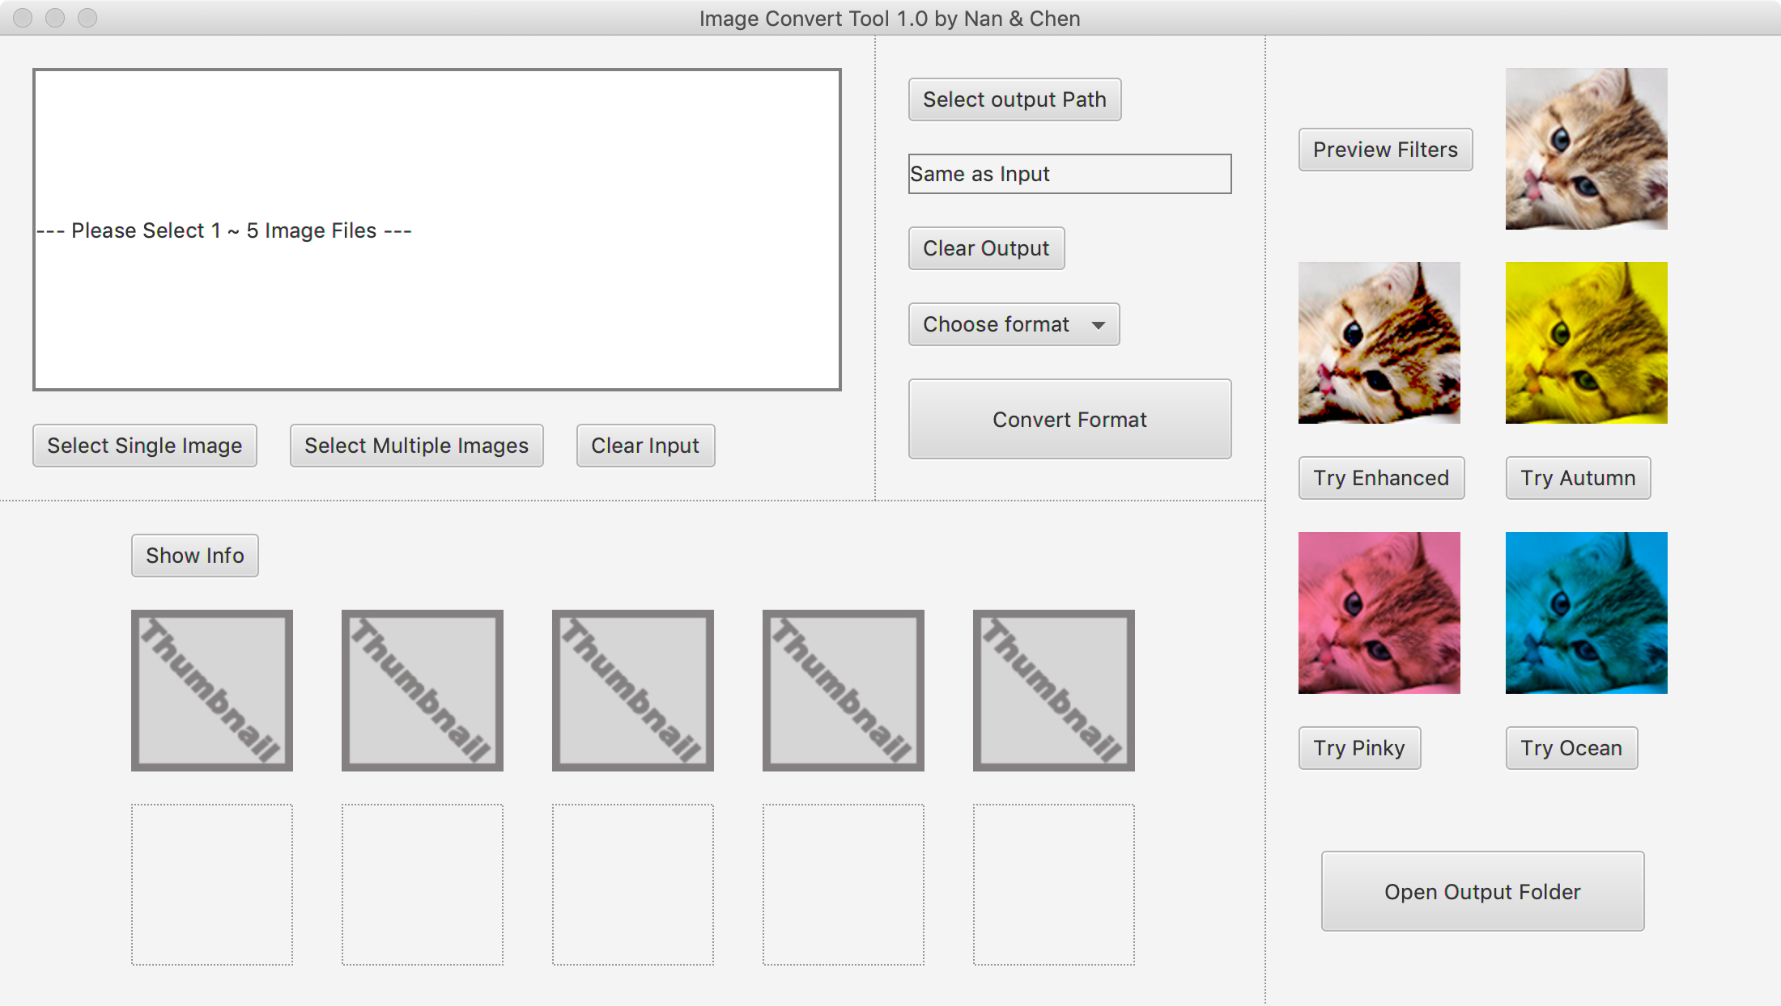
VBox
GridPane
VBox & HBox
GridPane
Notes:
Let’s move on to our user interface.
Let’s see the first part, we can submit single image or multiple images here. If we submit something wrong, we can click this button to clear all of them. After that, the pathway will show in the text field.
The second part, click this show info button, the thumbnail and information will be showed below.
The third part is the convert part. We can choose specific format whatever we want. Then click the convert format button, we can get the final image.
Finally, if you would like to choose your favourite filter, you can use this area. We provide 4 different filters in this part.

Slide 7
DEMO

